Slide 1
CVFX 2019
Homework 1
(color transfer , texture transfer)

Slide 2
Outline
Lab schedule
Score
Pytorch
GAN
CycleGAN
Running CycleGAN

Slide 3
Lab schedule
 | Lab | homework
第二週 | Pytorch + GAN＋ CycleGAN | Color transfer + texture transfer
第三週 | Q/A | Mutual evaluation hw1
第四週 | MUNIT | Style transfer
第五週 | Q/A , Top three presentation | Mutual evaluation hw2
第六週 | ….

Slide 4
Score
Color transfer + Texture transfer
20% (Training CycleGAN)
10% (Inference CycleGAN in personal image)
20% (Compare with other method)
30% (Assistant score)
20% (Mutual evaluation)

Slide 5
PyTorch
CVFX 2019 @ NTHU

Slide 6
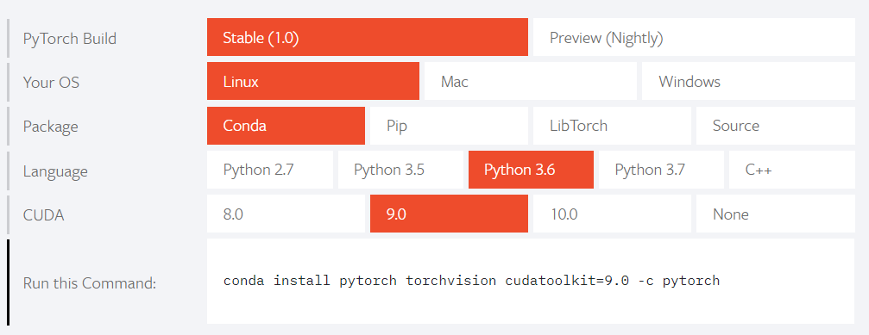
Install PyTorch
Website: https://pytorch.org/

Slide 7
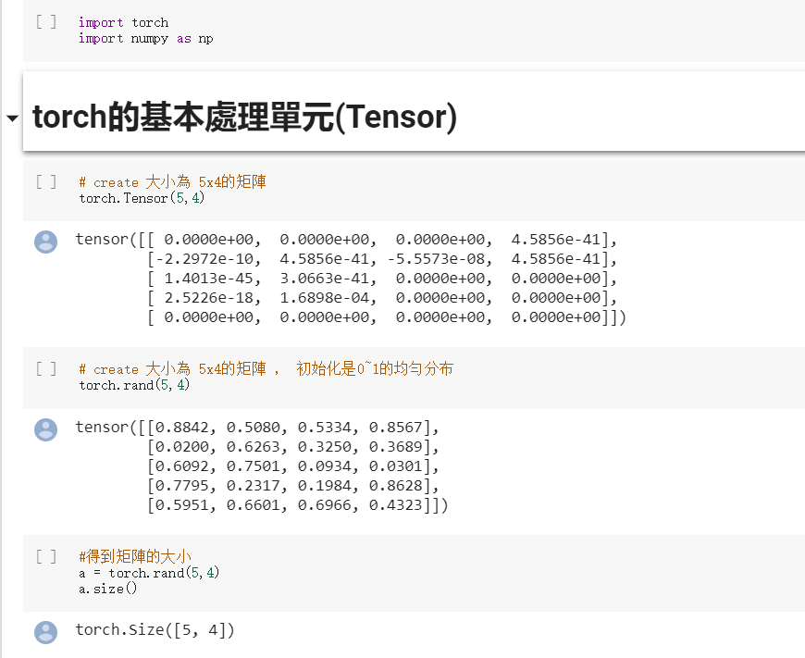

Slide 8
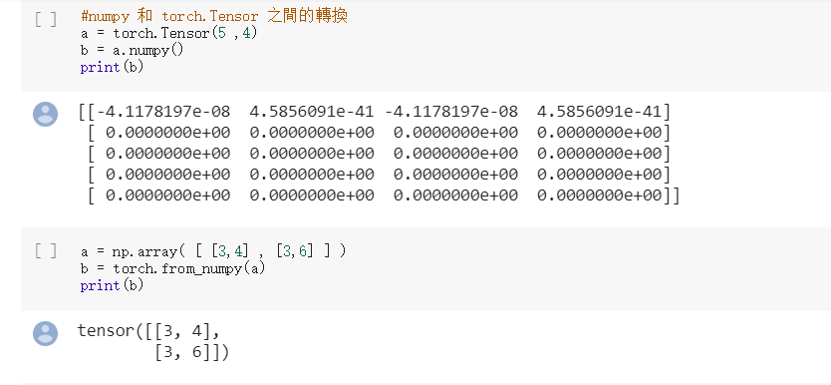

Slide 9
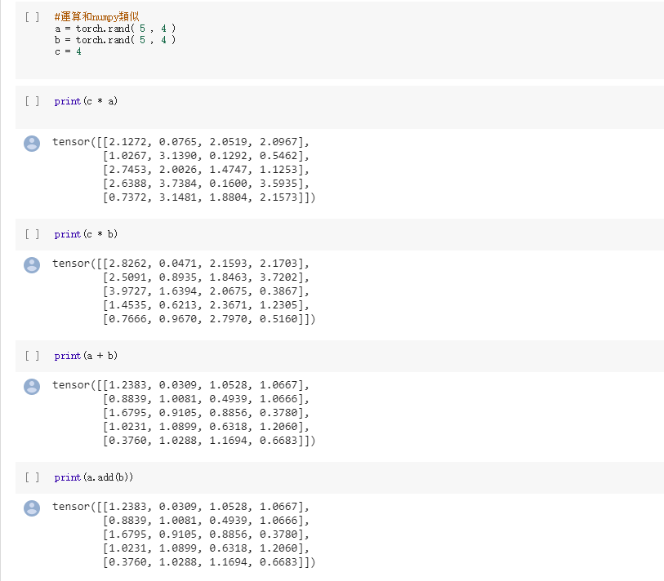

Slide 10
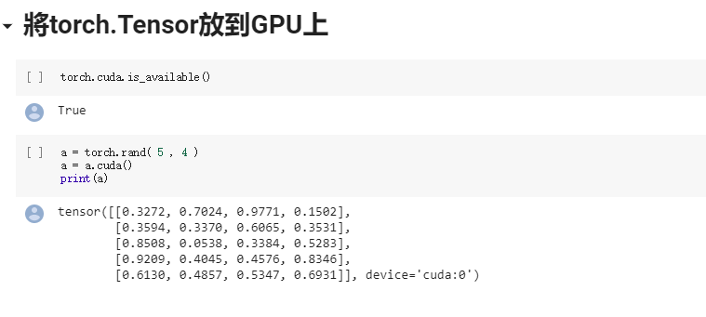

Slide 11
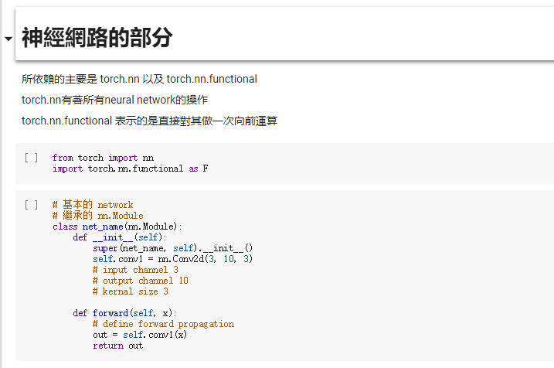

Slide 12
Generative Adversarial Network (GAN)
Reference: Hung-yi Lee, GAN ppt
CVFX 2019 @ NTHU
Notes:
GAN 生成對抗網路

Slide 13
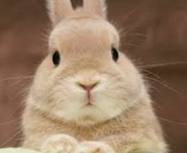
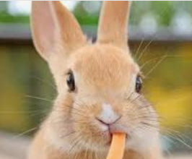
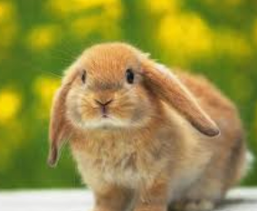
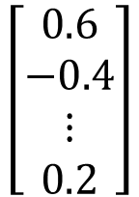
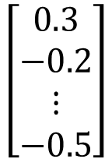
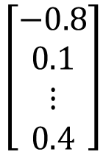
Generation
Conditional Generation
$$\left[\begin{aligned}0.3 \\ −0.2 \\ ⋮ \\ −0.5\end{aligned}\right]$$
NN
Generator
$$\left[\begin{aligned}0.6 \\ −0.4 \\ ⋮ \\ 0.2\end{aligned}\right]$$
$$\left[\begin{aligned}−0.8 \\ 0.1 \\ ⋮ \\ 0.4\end{aligned}\right]$$
In a specific range

Slide 14
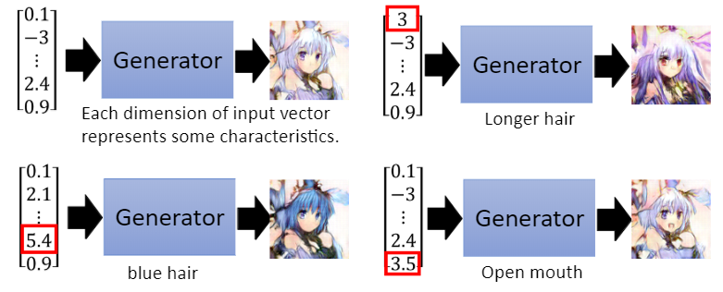
Basic Idea of GAN
Generator
(NN or a function)
vector
image
(high dimensional vector)

Slide 15
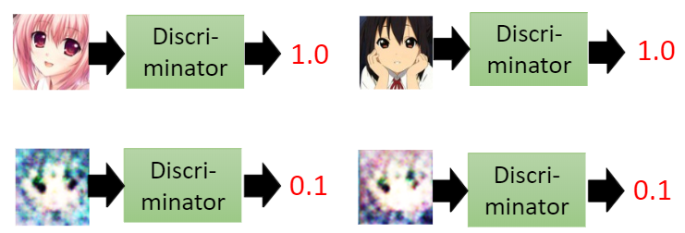
Basic Idea of GAN
Discriminator
(NN or a function)
scalar
(means image quality)
image
Larger value: real
Smaller value: fake

Slide 16
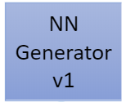
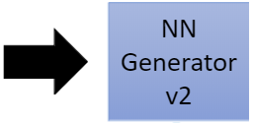
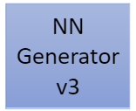
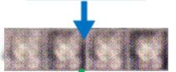
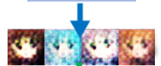
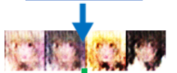
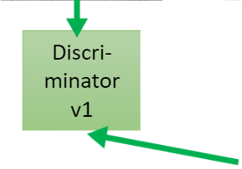
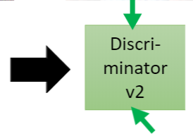
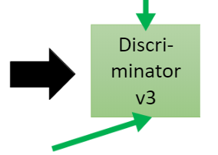

Basic Idea of GAN
This is where the term “adversarial” comes from.

Slide 17
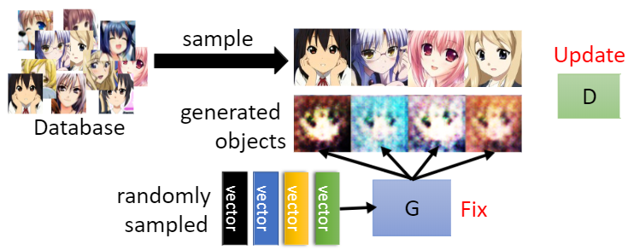
Algorithm
Random initialize generator and discriminator
G
D
In each training iteration:
Step 1: Fix generator G, and update discriminator D
1
1
1
1
0
0
0
0
Discriminator learns to assign high scores to real objects and low scores to generated objects.

Slide 18
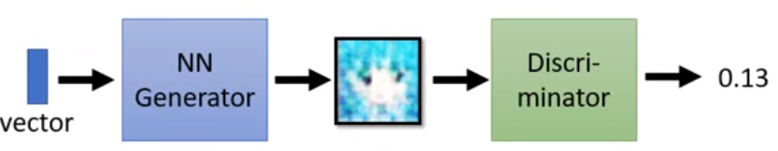

Algorithm
Random initialize generator and discriminator
G
D
In each training iteration:
Step 2: Fix discriminator D, and update generator G
Generator learns to “fool” the discriminator
hidden layer
update
fix
Large network

Slide 19
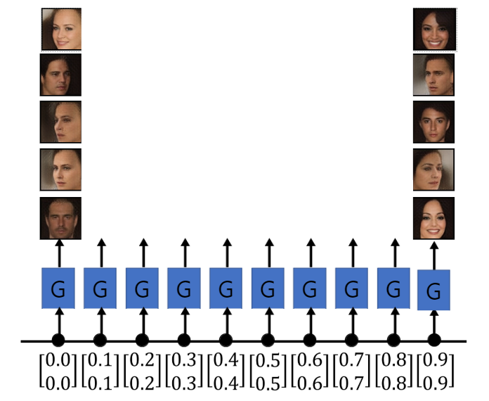
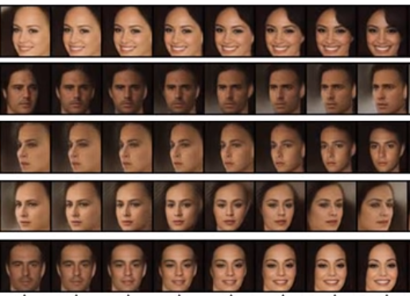

Slide 20

Unpaired Image-to-Image Translation
with CycleGAN
Jun-Yan Zhu and Taesung Park
Joint work with Phillip Isola and Alexei A. Efros

Slide 21
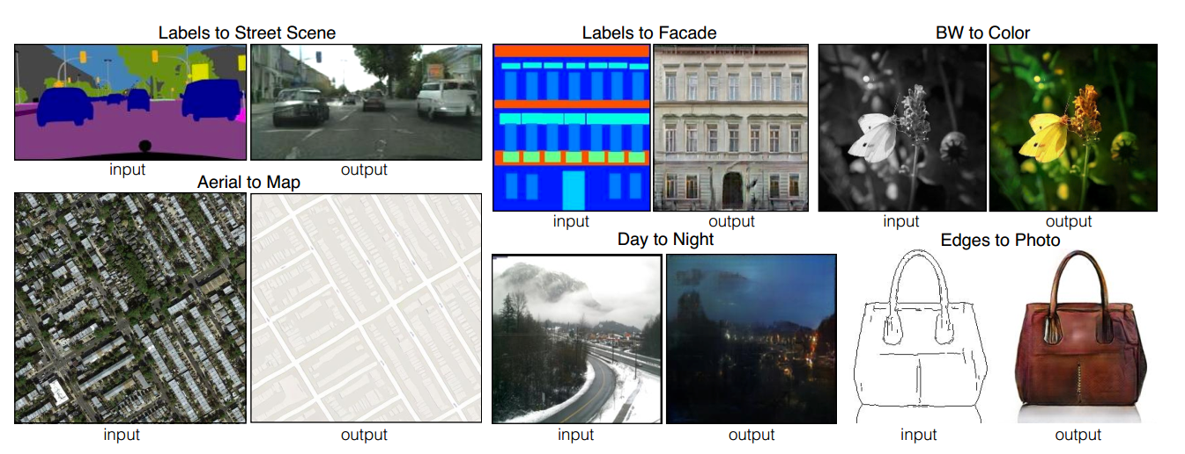
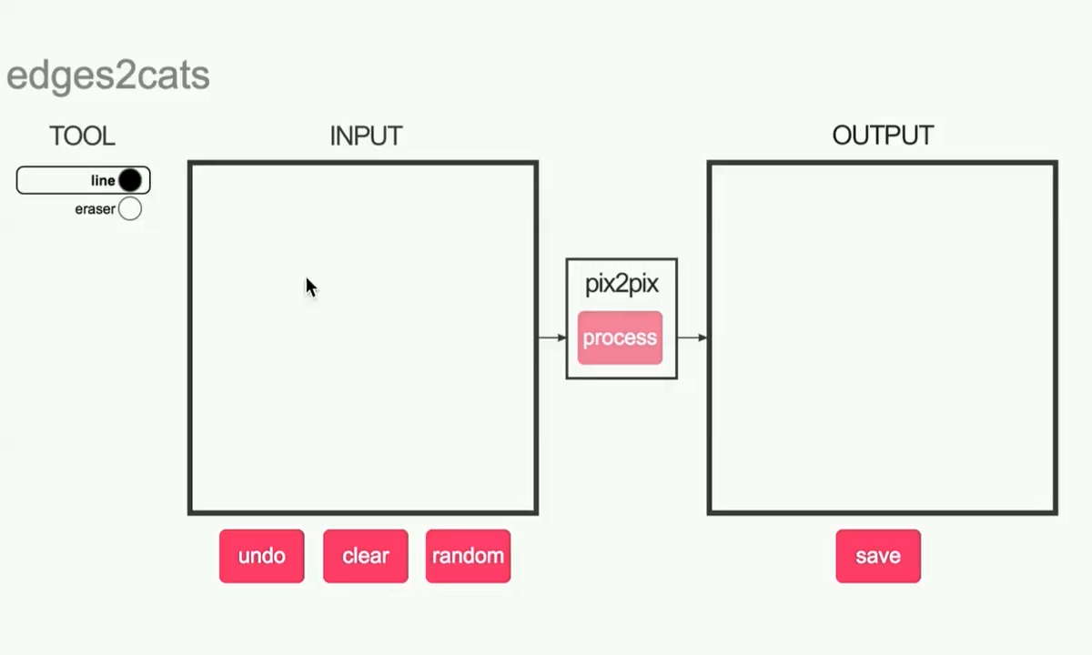
Image-to-Image Translation with pix2pix
Image-to-image Translation with Conditional Adversarial Nets
Phillip Isola, Jun-Yan Zhu, Tinghui Zhou, Alexei A. Efros. CVPR 2017

Slide 22
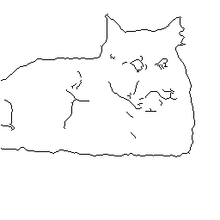
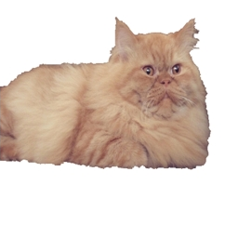
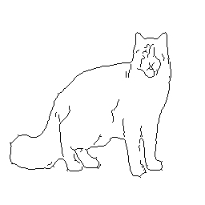
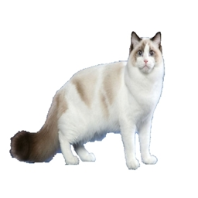
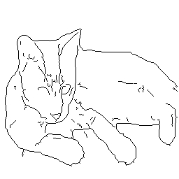
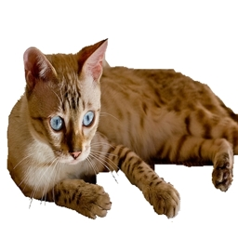

Paired
$$⋯$$

Slide 23
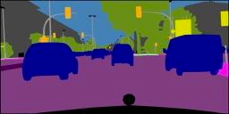
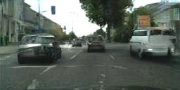

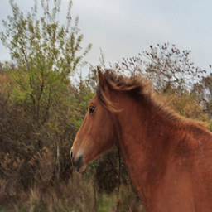


Paired
Label $↔$ photo: per-pixel labeling
Horse $↔$ zebra: how to get zebras?
- Expensive to collect pairs.
- Impossible in many scenarios.
$$⋯$$

Slide 24
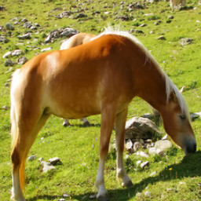
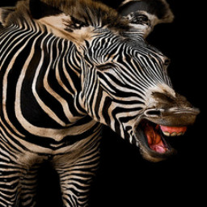
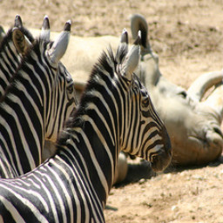
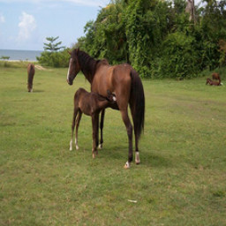
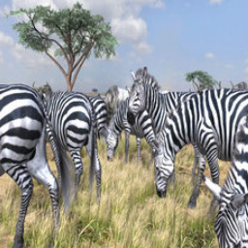
Paired
Unpaired
…
…
$$⋯$$

Slide 25
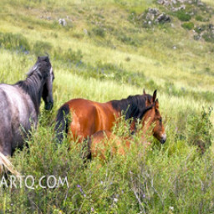
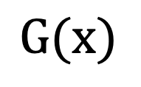

$$x$$
$$G(x)$$
$$G$$
Generator
$$D$$
No input-output pairs!

Slide 26
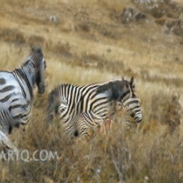
$$x$$
$$G(x)$$
$$G$$
$$D$$
Real!
Generator
Discriminator

Slide 27
$$x$$
$$G(x)$$
$$G$$
$$D$$
Real too!
Generator
Discriminator
GANs do not force output to correspond to input

Slide 28
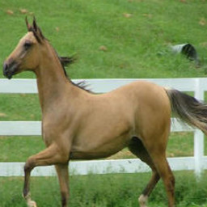
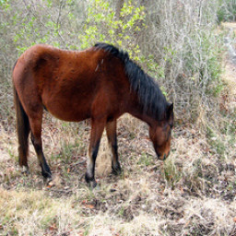
mode collapse!

Slide 29
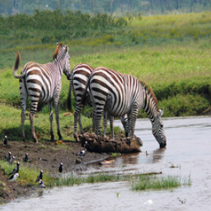
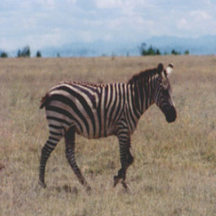


Cycle-Consistent Adversarial Networks
$$⋯$$
$$⋯$$
[Zhu*, Park*, Isola, and Efros, ICCV 2017]

Slide 30


Cycle-Consistent Adversarial Networks
$$⋯$$
[Mark Twain, 1903]
$$⋯$$
[Zhu*, Park*, Isola, and Efros, ICCV 2017]

Slide 31








Cycle-Consistent Adversarial Networks
$$x$$
$$G(x)$$
$$F(G\left(x\right))$$
$$D_{Y}(G\left(x\right))$$
Reconstruction
error
$${\left\|F\left(G\left(x\right)\right)−x\right\|}_{1}$$
[Zhu*, Park*, Isola, and Efros, ICCV 2017]

Slide 32
Cycle Consistency Loss
Large cycle loss
Small cycle loss
$$x$$
$$G(x)$$
$$F(G\left(x\right))$$
$$D_{Y}(G\left(x\right))$$
Reconstruction
error
$${\left\|F\left(G\left(x\right)\right)−x\right\|}_{1}$$
[Zhu*, Park*, Isola, and Efros, ICCV 2017]

Slide 33







Cycle Consistency Loss
$$x$$
$$G(x)$$
$$F(G\left(x\right))$$
$$y$$
$$F(y)$$
$$G(F\left(x\right))$$
$$D_{Y}(G\left(x\right))$$
$$D_{G}(F\left(x\right))$$
Reconstruction
error
Reconstruction
error
$${\left\|F\left(G\left(x\right)\right)−x\right\|}_{1}$$
$${\left\|G\left(F\left(y\right)\right)−y\right\|}_{1}$$
See similar formulations [Yi et al. 2017], [Kim et al. 2017]
[Zhu*, Park*, Isola, and Efros, ICCV 2017]

Slide 34
Results

Slide 35



Monet’s paintings $→$ photos

Slide 36









Slide 37




CG2Real: GTA5 $→$ real streetview
GTA5 CG Input
Output
Inspired by [Johnson et al. 2011]

Slide 38

Real2CG: real streetview $→$ GTA
Cityscape Input
Output

Slide 39
Code and impelementation
https://github.com/cvfx-2019/homework1-color-transfer

Slide 40
END

